Slide 1

Doctor Fee Prediction
in different Cities
Prepared By:-
Aishwarya Singh Gaur (pd14_191)

Slide 2
Problem Statement
To build a ML Model to predict the consultancy fee of Doctors on Practo website.
For this project I have to Scrape the doctors’ data from Practo website using python library called Beautiful soup and Selenium and collect information like:
Name - Name of the doctor
Specialty of doctor - Their specialty like dentist, Gynecologist, pediatrician etc.
Degree type - like MBBS, MS, MD, BDS etc.
Year of experience - Total year of experience Location - Location of clinic
City - City of the clinic
Dp score - This will be doctor patient experience score
npv - Number of people votes
Consult fee - Consultation fee at clinic

Slide 3
Work Flow
Data Collection Via Web Scraping
Data Cleaning
And EDA
ML Model
Analysis
Dashboard
Insights
I have used Beautiful Soup and Selenium library in python for Data collection.
For Data cleaning I have used Python.
For analysis I have used Excel Pivot tables.
Created Dashboard using Excel.

Slide 4
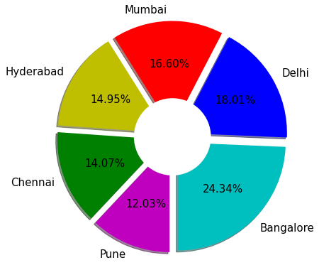
Doctors In Each City

Slide 5
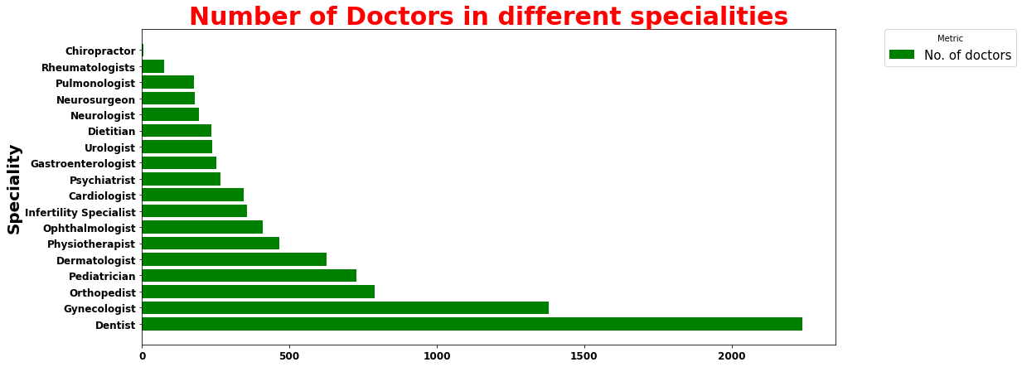

Slide 6
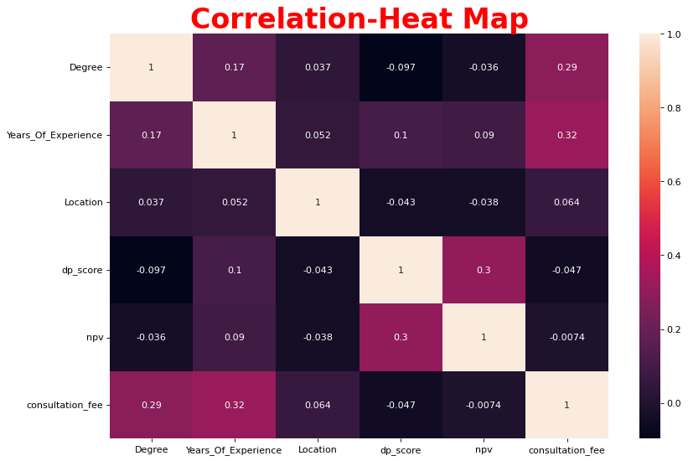

Slide 7
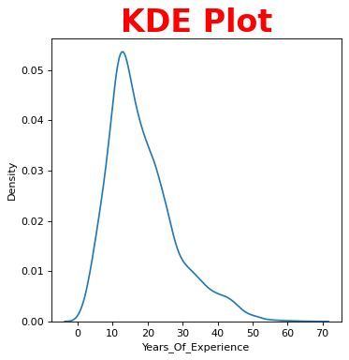

Slide 8
Speciality wise Fees Analysis
Speciality_of_doctor | consultation_fee
 |  | min | max | median
0 | Cardiologist | 300 | 3300 | 900.0
1 | Chiropractor | 600 | 3000 | 2500.0
2 | Dentist | 0 | 2000 | 350.0
3 | Dermatologist | 0 | 3100 | 700.0
4 | Dietitian | 0 | 5000 | 800.0
5 | Gastroenterologist | 300 | 2500 | 800.0
6 | Gynecologist | 0 | 3000 | 700.0
7 | Infertility Specialist | 0 | 3000 | 700.0
8 | Neurologist | 400 | 4100 | 900.0
9 | Neurosurgeon | 400 | 3500 | 950.0
10 | Ophthalmologist | 0 | 5000 | 630.0
11 | Orthopedist | 200 | 4500 | 700.0
12 | Pediatrician | 0 | 3000 | 750.0
13 | Physiotherapist | 0 | 3000 | 500.0
14 | Psychiatrist | 400 | 4000 | 1200.0
15 | Pulmonologist | 99 | 2100 | 800.0
16 | Rheumatologists | 300 | 2500 | 900.0
17 | Urologist | 0 | 3500 | 800.0

Slide 9
Count of doctors (Top5) acoording to location and city
City | Location | Name
157 | Bangalore | Whitefield | 132
485 | Hyderabad | Jubilee Hills | 124
17 | Bangalore | Bannerghatta Road | 120
414 | Delhi | Sarita Vihar | 110
57 | Bangalore | Indiranagar | 106

Slide 10
Doctors holding maximum number of Specialties
index | Name
0 | Dr. Vaishali Chaudhary | 4
1 | Dr. Praveen Kumar | 4
2 | Dr. Rahul Patil | 4
3 | Dr. Gaurav Garg | 4

Slide 11
Linear Regression Model
Before PCA
MSE = 93471.59
RMSE = 305.73
R-squared = 0.50
After PCA
MSE = 93876.22
RMSE = 306.39
R-squared = 0.51

Slide 12
THANK YOU

